Slide 1
Facial Acne Detection System
Team Memphis
Chenhao Li, Hao Liu, Haoze Liu, Mingyang Yu

Slide 2
Content
Part 1
Problem clarification
Part 2
Challenge and Solutions
Method explanation
Part 3
Current code and Result
Part 4
Future Improvements and Conclusion
Speaker: Hanze

Slide 3
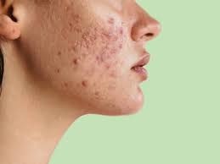
Background
Acne is a common dermatological condition affecting individual of all ages
Manual acne detection can be subjective, Time-consuming, and prone to errors
The goal is to develop an automated, Computer-vision-based system to identify and assess facial acne conditions
Speaker:Hanze
Notes:
Acne is one of the most common skin conditions out there—it doesn’t discriminate by age, showing up for teenagers, adults, and everyone in between. It can be a source of frustration, and dealing with it is no easy task.Traditionally, this relies on manual observation by dermatologists, which can be subjective, time-consuming, and prone to errors.
Our solution? An automated, computer-vision-based system for identifying and assessing acne. This technology makes detection faster, more accurate, and completely objective, providing consistent results to guide treatments and skincare routines.

Slide 4
Objective
Accurately detect acne spots on facial images
Classify acne types (nodule, papule, pustule)
Provide a quantitative assessment for dermatological insights.
Speaker:Hanze
Notes:
Our goal with this system is simple and clear. First, we aim to accurately detect acne spots on facial images, ensuring precise and reliable results. Next, we want to classify different types of acne to provide detailed insights. Lastly, we strive to offer a quantitative assessment, analyzing factors like acne size and distribution to support both professional dermatologists and personal skincare routines.

Slide 5
Code Overview : Beginning
Running Code
Full Detection
Selecting
Image
Continue
User Selecting Mode
Local Face Detection
Selecting image
Continue
Speaker:
Notes:
Here is the flow chart for the Full face detection, we will separate two parts, the first one is using LAB color space to detect the acne and second one is eye bags detection and combine two result together and get the output results

Slide 6
Code Overview : Full Face Detection
Input
image
Draw Contours
Convert to LAB Space and Extract A Channel
Detect Red Regions
Calculate Score
Classify Acne
Mask Mouth and Eye
Detect bags under eyes
Output Results
Speaker: Hao Liu
Notes:
Here is the flow chart for the Full face detection, we will separate two parts, the first one is using LAB color space to detect the acne and second one is eye bags detection and combine two result together and get the output results

Slide 7
Code Overview : Local Face Detection
Input
image
H < 10
S > 70
V > 50
Green Channel Separation
User Select the Region Of Interest
Find Contour
Not Acne
Output Results
Classify Acne
Effective Contour
Speaker: Hao Liu
Notes:
Here is the flow chart for the Local Face Detection, firstly, we will use the green channel to do the first acne detection and then we will use the HSV to make a decision to filter out the mostly possible acne and give the user the final output image.

Slide 8
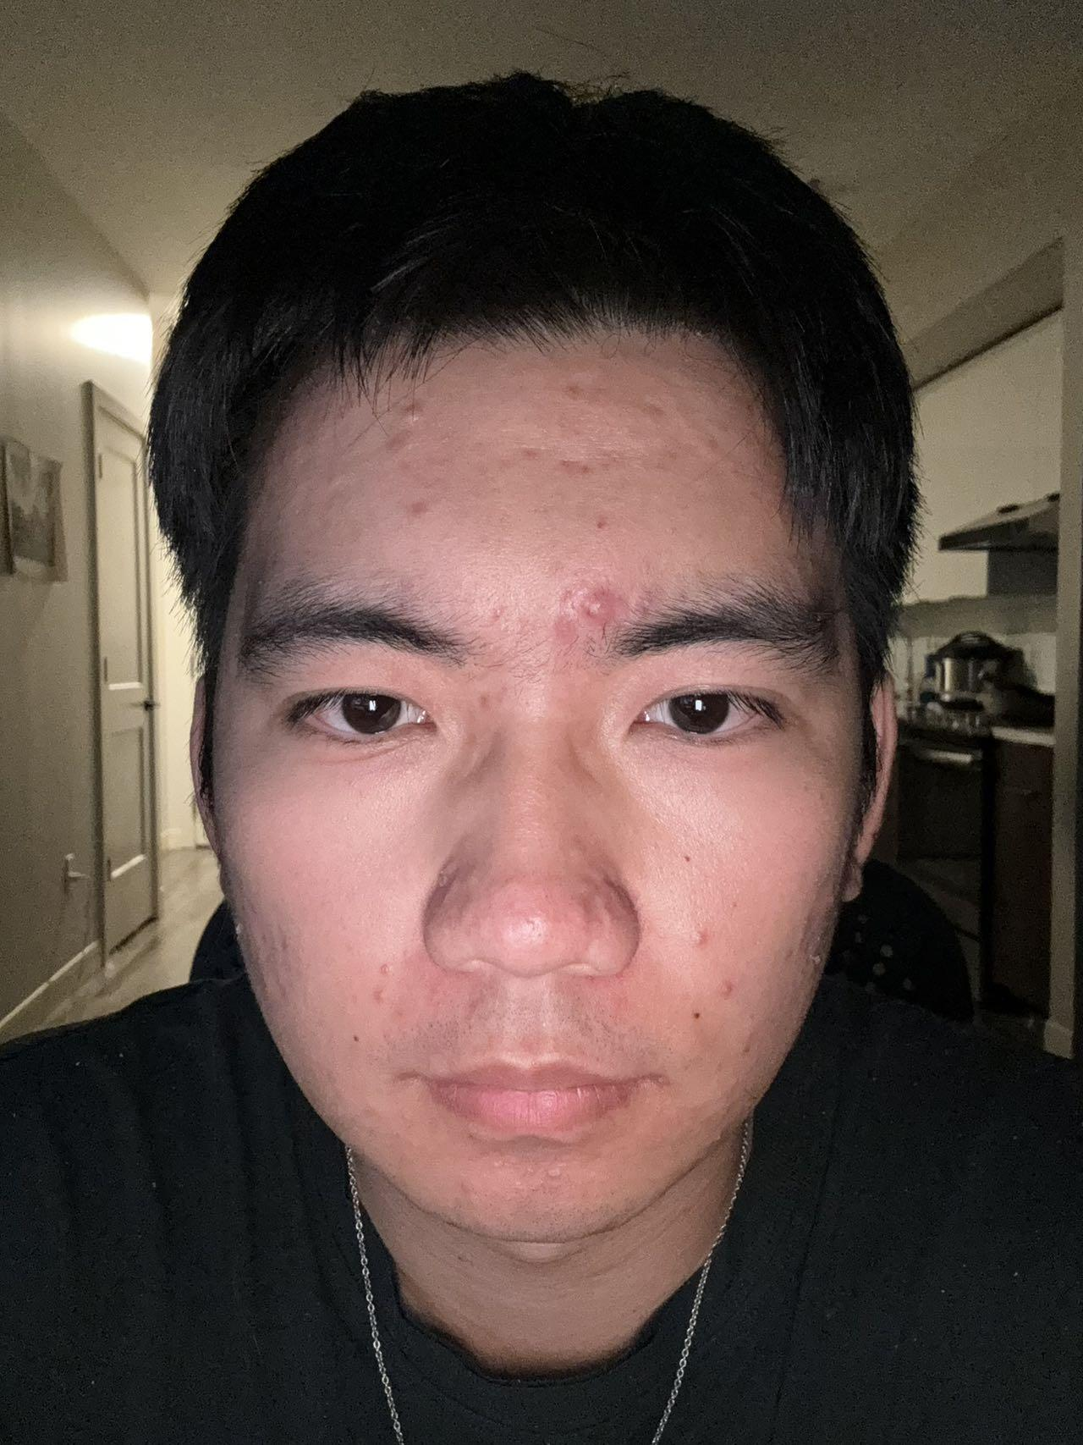
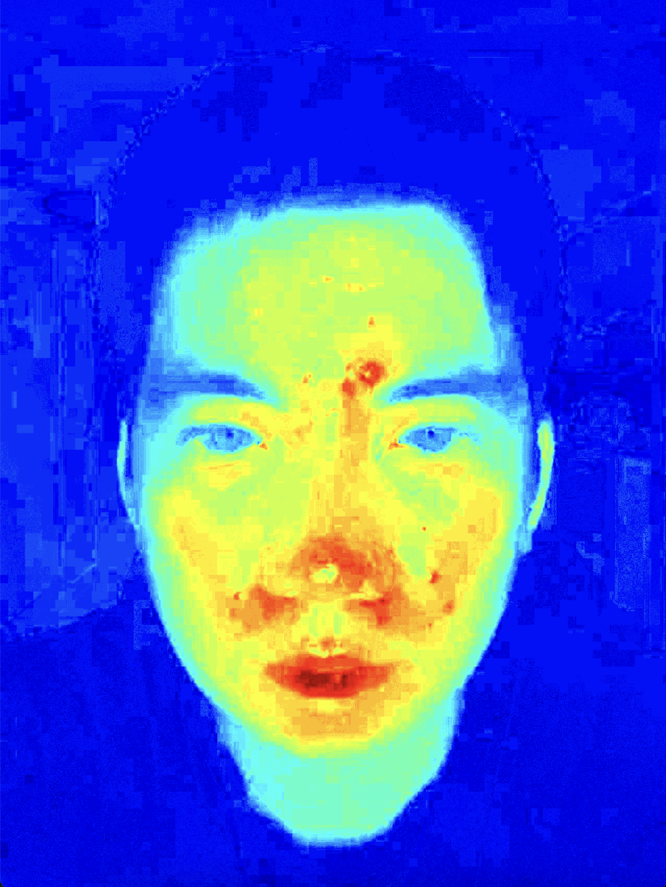
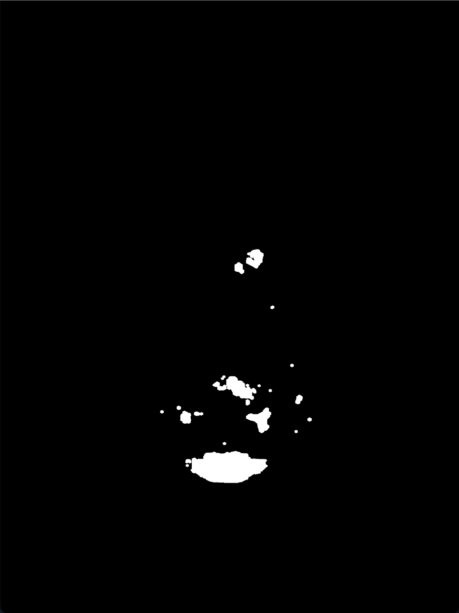
Method Explanation - Finding Acne
Fundamental Way to Identify Acne Areas
A-channel from the LAB color space
Efficient Identification
Top 0.1% Redness
Filtering:
Gaussian Blurring
Dilation
Original Image
A-Channel
Color Map
Top 0.1%
Redness
Speaker: Chenhao
Notes:
The analysis is based on the A-channel of the LAB color space.
Why LAB?
LAB color space separates lightness (L) making it ideal for isolating redness.
The A-channel specifically captures the green-to-red spectrum.
—-----------------------
The top 0.1% redness threshold is used to focus on the potential red regions in the A-channel.
This ensures areas likely to be acne, are considered, while ignoring noise
—--------------------
Gaussian Blurring:
Smooths the A-channel to reduce noise.
Dilation:
Expands the detected red regions to ensure complete coverage of acne spots.

Slide 9
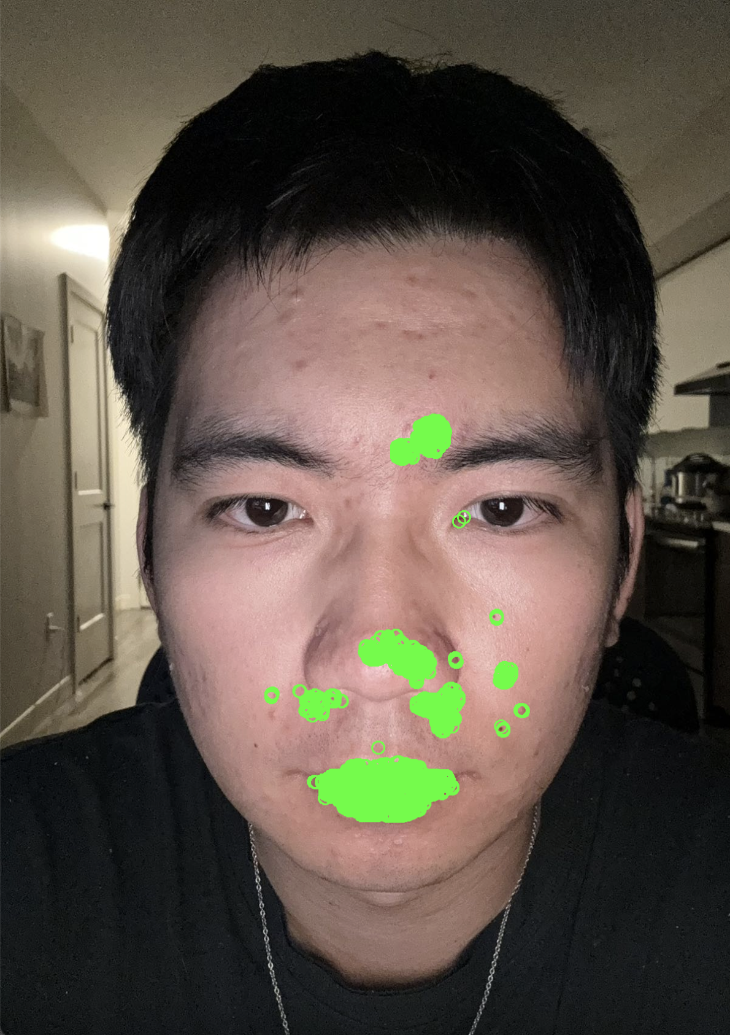
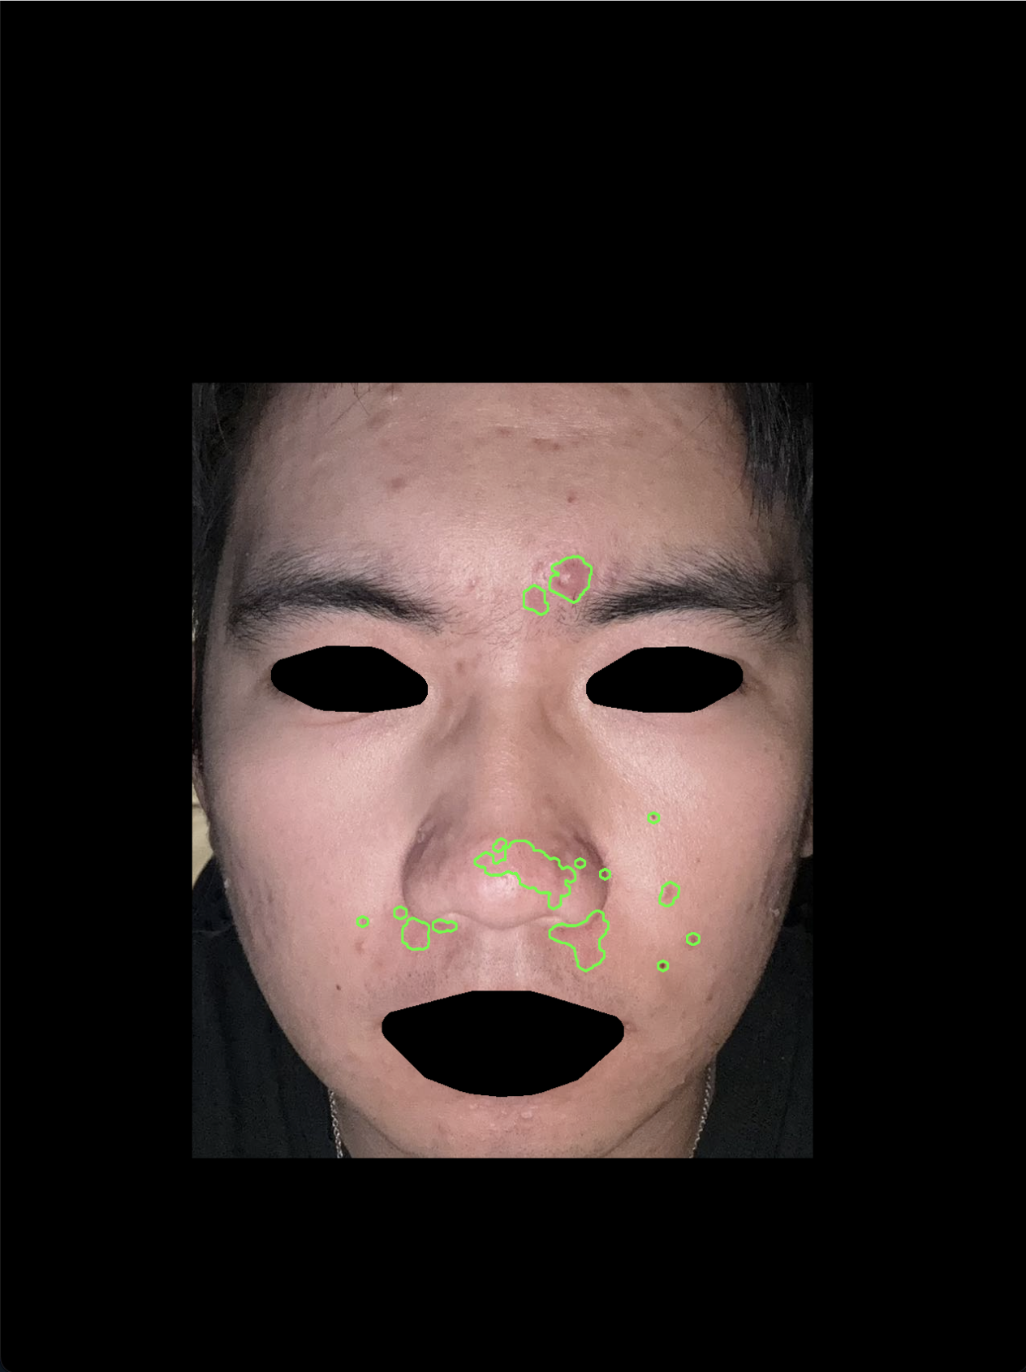
Challenge and Solutions
False detection :
Masking Using dlib face detector
Original Image
Redness on Eyes and Mouth
Mask Background Eyes and Mouth
Speaker: Chenhao
Notes:
False Detection:
Challenge:
The face detection algorithm might include irrelevant areas or miss features, leading to inaccurate analysis.
Solution:
Used dlib's facial landmark detector to create precise masks that isolate the face while excluding the eyes, mouth, and background.

Slide 10
Method Details - Finding Acne for Full face
Image Preprocessing:
The input image is resized to a standard width for consistency.
Grayscale conversion is applied to the image to simplify computations.
Facial Features Masking:
The FaceMasker class uses Dlib's 68 facial landmarks to locate specific facial regions (mouth, eyes, and eyebrows).
Masks are generated for these regions using polygons and dilation to cover the features completely.
An inverted mask is applied to hide these regions from further processing.
Redness Detection:
The LAB color space is used, and the a-channel is extracted to emphasize redness.
High red-intensity regions are identified by thresholding the a-channel based on the top percentage of redness values.
Morphological operations like dilation expand the red areas for better detection.
Acne Classification:
Each red region is classified as a papule, pustule, or nodule by comparing it with pre-saved ground truth images. Similarity is calculated using histogram correlation.
Scoring Skin Condition:
The skin condition is scored based on the number of contours and the average redness of the detected regions.
Speaker: Chenhao
Notes:
The analysis is based on the A-channel of the LAB color space.
Why LAB?
LAB color space separates lightness (L) making it ideal for isolating redness.
The A-channel specifically captures the green-to-red spectrum.
—-----------------------
The top 0.1% redness threshold is used to focus on the potential red regions in the A-channel.
This ensures areas likely to be acne, are considered, while ignoring noise
—--------------------
Gaussian Blurring:
Smooths the A-channel to reduce noise.
Dilation:
Expands the detected red regions to ensure complete coverage of acne spots.

Slide 11
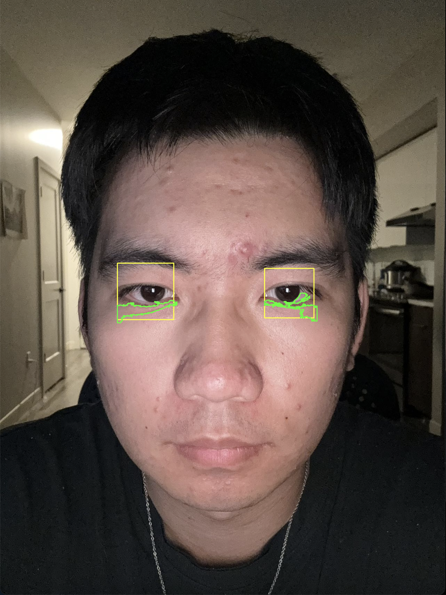
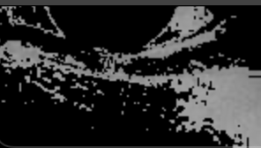
Method Explanation - Eye Bag & Dark Circle
Eye detection
Implement cv2.CascadeClassifier()
Create bounding rectangle
Eye bag and dark circle detection
Extract the lower half the eye rectangle
Use cv2.bitwise_or to filter the image with
lower and upper threshold bound
Draw the contour
Sort the contours and draw the largest one
Binary image of lower part of the eye
Detected dark circle
Speaker: Mingyang Yu
Notes:
In addition to acne detection, our program can also detect eye bad and dark circle under the eyes. To do it, we first use eye detection, which is achieved by cascade classifier function that creates bounding rectangle around eyes. Then, we extract the lower half of eye rectangle and the bitwise or function to filter it. Lastly, draw the contours for the largest white region which represent the eye bad and dark circle

Slide 12
Method Details - Finding Eye Bag
Face Detection:
The function uses Haar cascades (haarcascade_frontalface_default.xml) to detect the face region.
This restricts processing to the detected face area, making subsequent operations more efficient and targeted.
Eye Region Extraction and Eye Detection:
After detecting the face, only the upper half of the face region (top part of the detected face bounding box) is processed to locate the eyes.
This is achieved by slicing the grayscale image and color image to focus on the top-half region.
Haar cascades (haarcascade_eye.xml) are used to detect eyes within the cropped face area.
Detected eye regions are returned as bounding rectangles (x, y, width, height).
Eye Bag Region Identification and Intensity Analysis:
A region below the eye is identified as the potential eye bag region. This is done by slicing the area directly below the detected eye’s bounding rectangle, extending slightly downward.
The extracted eye bag region is analyzed for pixel intensities: 1. A range of intensity values (e.g., between 120 and 150) is selected to isolate darker regions typically associated with eye bags. 2. A mask is created using cv2.inRange to highlight these darker areas.
The mask highlights potential eye bag regions where skin is darker or shadowed.
Contour Detection:
Contours are detected within the masked region to localize eye bags. Also, detected contours are adjusted to account for the offset of the eye's bounding rectangle (adjusting coordinates to fit the original image).
Speaker: Chenhao
Notes:
The analysis is based on the A-channel of the LAB color space.
Why LAB?
LAB color space separates lightness (L) making it ideal for isolating redness.
The A-channel specifically captures the green-to-red spectrum.
—-----------------------
The top 0.1% redness threshold is used to focus on the potential red regions in the A-channel.
This ensures areas likely to be acne, are considered, while ignoring noise
—--------------------
Gaussian Blurring:
Smooths the A-channel to reduce noise.
Dilation:
Expands the detected red regions to ensure complete coverage of acne spots.

Slide 13
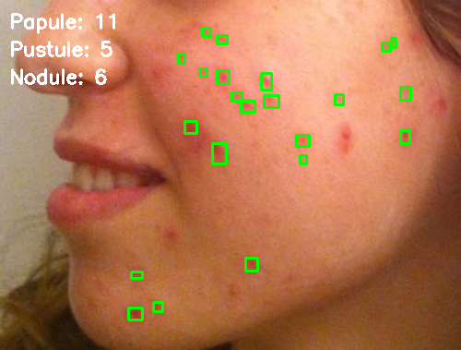
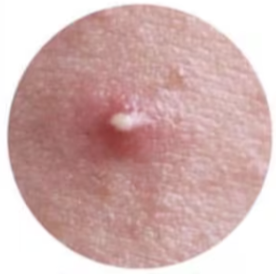
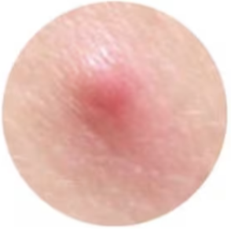
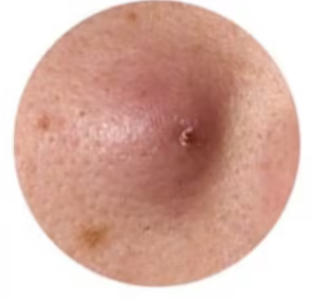
Other Features - Acne Classification
Ground truth acne images
Three types of acnes
Method: Normalized histogram comparison (using gray scaled images)
pustule
papule
nodule
Speaker: Mingyang Yu
Notes:
Our program also has some small features such as acne classification. Different types of acnes reflect different body conditions. For example, eating hot pot, feeling stressed, staying up late can all cause different ances, that why we want to classify them. Here we have three ground truth images which represents pustule, papule and nodule. By comparing each acne contour to the ground truth images, our program successfully classifies the acnes.

Slide 14
Method Details - Finding Acne Classification
Reference Images:
Three reference images (papule.jpg, pustule.jpg, nodule.jpg) are loaded. Each represents one type of acne.
Similarity Calculation:
Steps for calculating similarity:
Convert the detected region and reference images to grayscale using cv2.cvtColor.
Compute the histograms for both images using cv2.calcHist.
Normalize the histograms using cv2.normalize.
Compare histograms using cv2.compareHist with the cv2.HISTCMP_CORREL metric, which measures the correlation between histograms.
Classification:
For each detected acne region:
Similarity scores are computed for all three reference images.
The reference image with the highest similarity score determines the classification (papule, pustule, or nodule).
Speaker: Chenhao
Notes:
The analysis is based on the A-channel of the LAB color space.
Why LAB?
LAB color space separates lightness (L) making it ideal for isolating redness.
The A-channel specifically captures the green-to-red spectrum.
—-----------------------
The top 0.1% redness threshold is used to focus on the potential red regions in the A-channel.
This ensures areas likely to be acne, are considered, while ignoring noise
—--------------------
Gaussian Blurring:
Smooths the A-channel to reduce noise.
Dilation:
Expands the detected red regions to ensure complete coverage of acne spots.

Slide 15
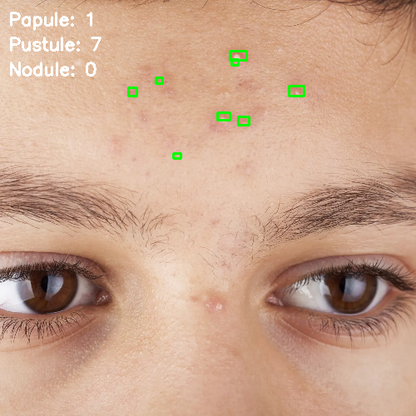
Enhancing Acne Detection with Local Face detection
Facial Region Selection
Allow users to select specific areas (e.g., forehead, cheeks, chin).
Use a bounding rectangle to isolate the chosen region for analysis.
Localized Acne Detection
Apply acne detection algorithms only within the selected region.
Use color filtering and HSV to identify acne spots.
Improved Accuracy
Focus on smaller areas reduces interference from unrelated features.
Analyze regional patterns for better precision in detection.
Speaker: Hao Liu
Notes:
For the local face detection, our program allow user use the mouse to select the region of interest, for the choosed ROI, we separate the green channel because the green channel is commonly used in image medical processing to deal with skin damage and the green channel will not effect by light and dark condition. Then, use the HSV to do the second threshold for acne detection.

Slide 16
Method Details - Finding Acne for Local face
Interactive Region Selection:
Using mouse clicks, the user defines a polygonal area. A mask is created for this region.
Region Processing:
Within the selected region, the green channel of the image is processed to detect acne.
Adaptive thresholding is applied to highlight potential acne areas.
Contour Filtering:
Contours are extracted from the thresholded region, representing possible acne spots.
Contours are filtered based on their size (to exclude noise) and color characteristics in HSV space (to focus on redness and inflammation).
Acne Classification:
Similar to the full detection method, each detected region is classified as papule, pustule, or nodule by comparing it with ground truth images.
Speaker: Chenhao
Notes:
The analysis is based on the A-channel of the LAB color space.
Why LAB?
LAB color space separates lightness (L) making it ideal for isolating redness.
The A-channel specifically captures the green-to-red spectrum.
—-----------------------
The top 0.1% redness threshold is used to focus on the potential red regions in the A-channel.
This ensures areas likely to be acne, are considered, while ignoring noise
—--------------------
Gaussian Blurring:
Smooths the A-channel to reduce noise.
Dilation:
Expands the detected red regions to ensure complete coverage of acne spots.

Slide 17
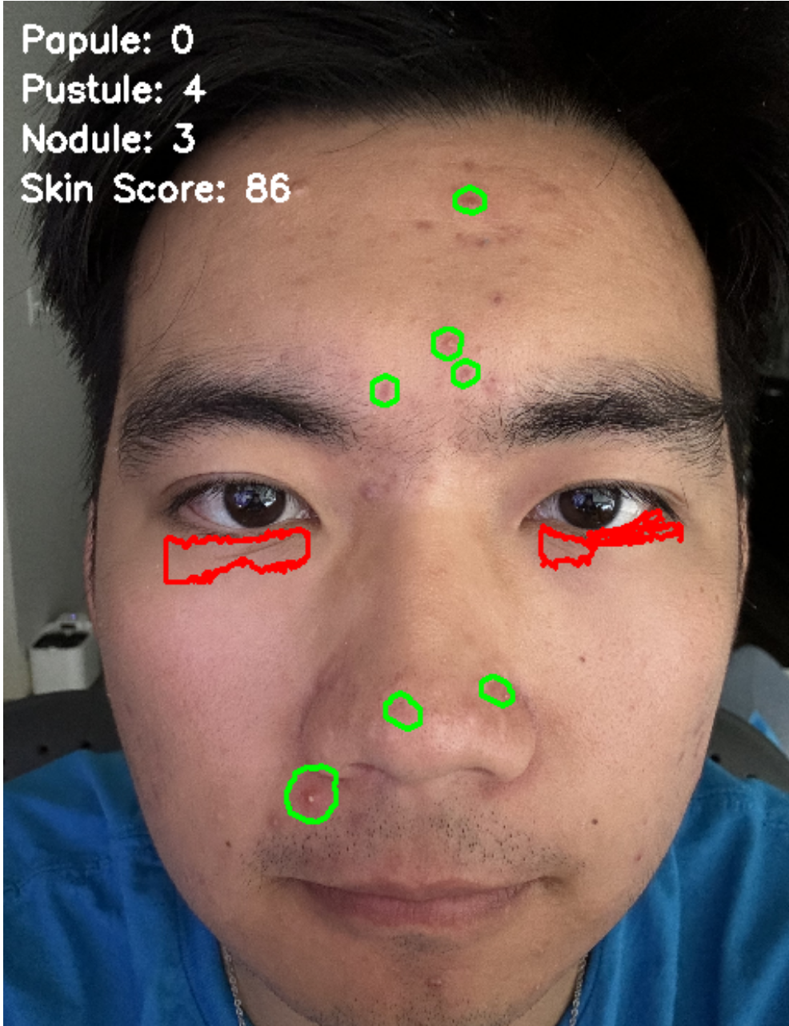
Other Features - Facial Condition Score
Two key metrics evaluate for the score
Number of Detected Contours
Average Redness Intensity
Scoring Formula
score = max(0, 100 - num_contours * 2 - int(average_redness / 500))
Score Range:0 - 100
Speaker: Chenhao

Slide 18

Code Demonstration
Speaker: Chenhao

Slide 19
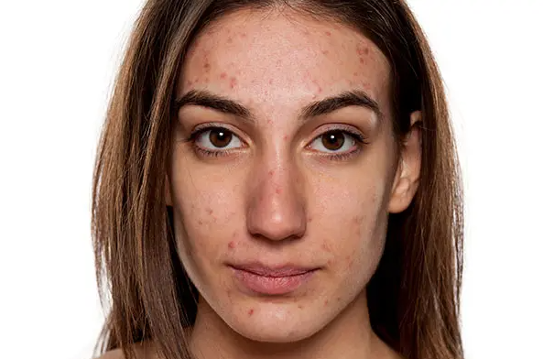
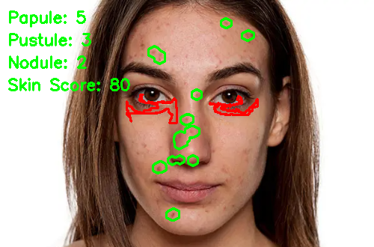
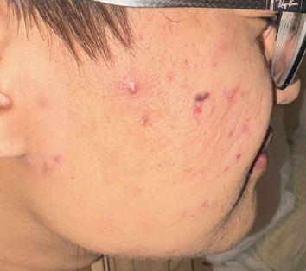
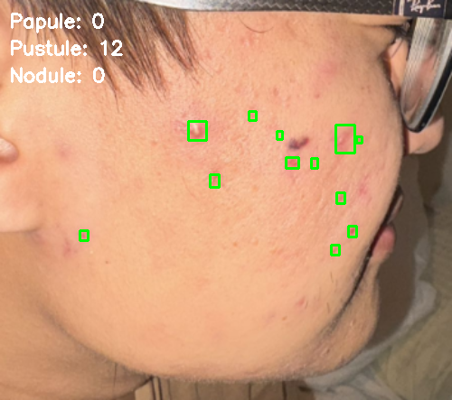

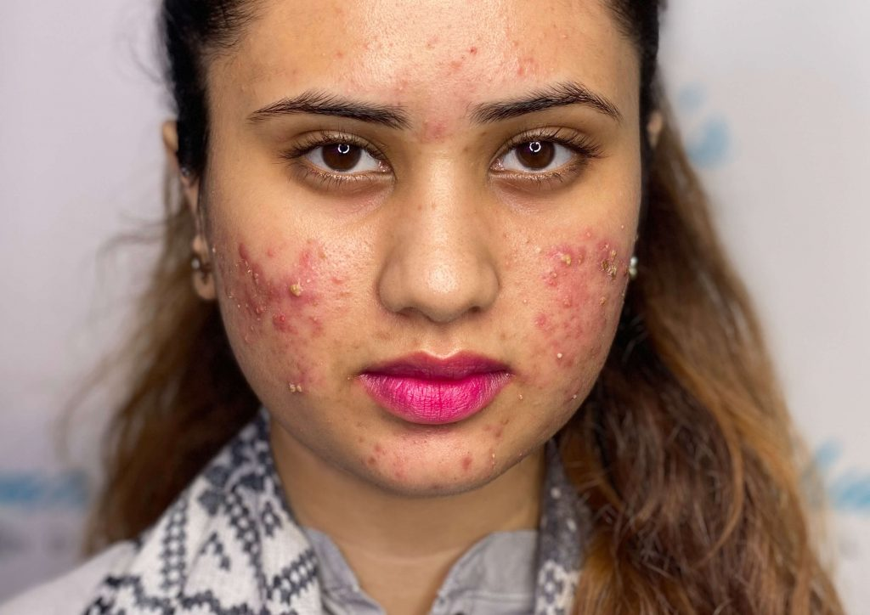
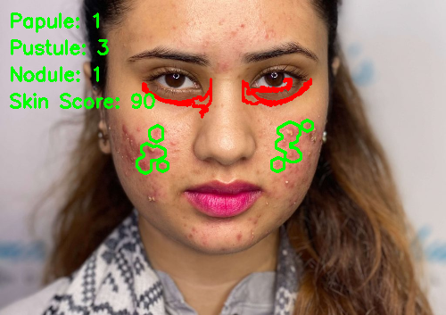
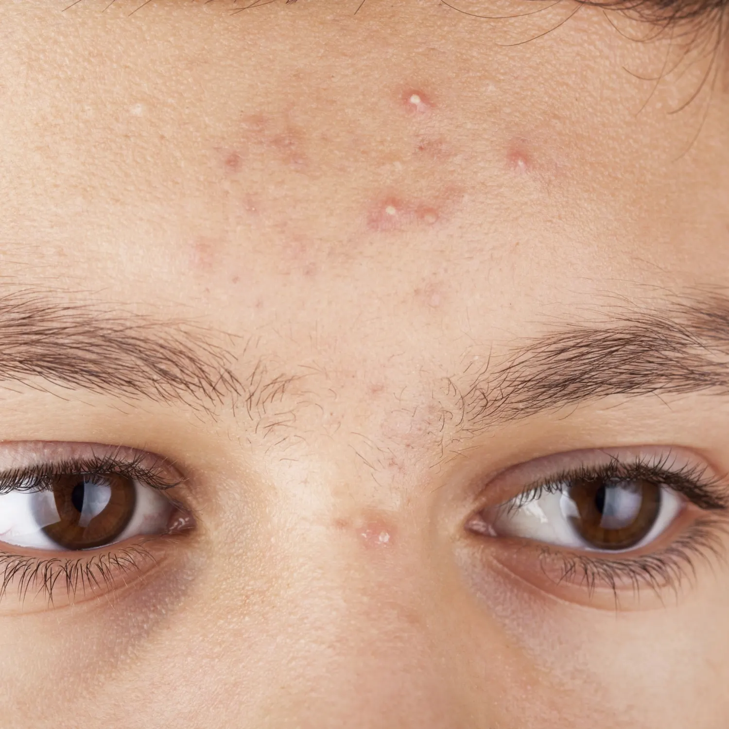


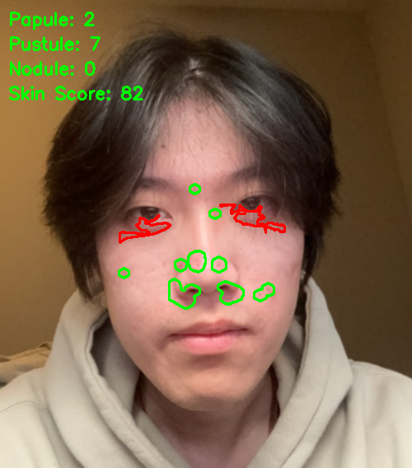
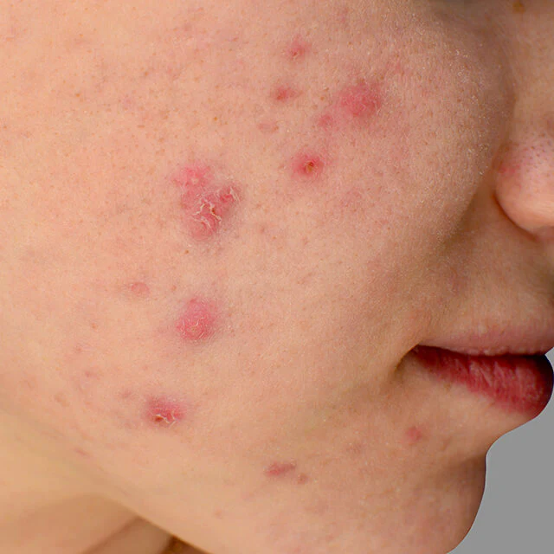
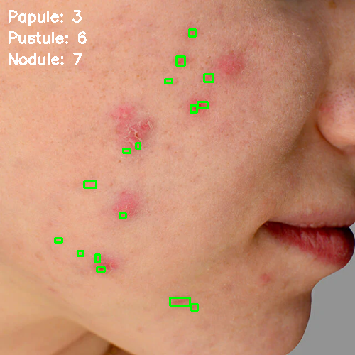
Some Results:
Full Face Detection Local Face Detection
Speaker: Chenhao

Slide 20
Data Images
Full Face Detection : 7 images
Accuracy: 80%
Local Face Detection: 5 images
Accuracy: 95%
Speaker:

Slide 21
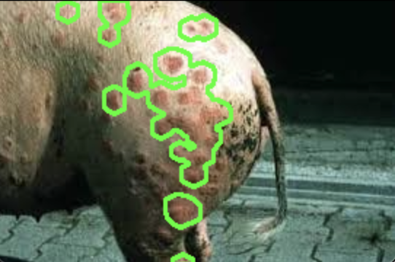
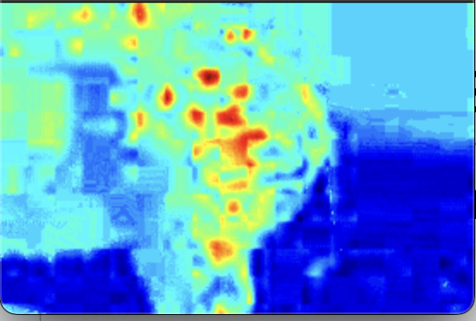
Other Possible Implementation
Disease detection for livestock
Swine Erysipelas
Speaker: Mingyang Yu
Notes:
Now, after seeing these results, our program does do a pretty good job. We start to think what else, or what other field can our program be implemented. The first example is the livestock industry. Here’s a image of a pig that has Swine Erysipelas which is an infectious disease. With the help of our program, these disease can be detected earlier.

Slide 22
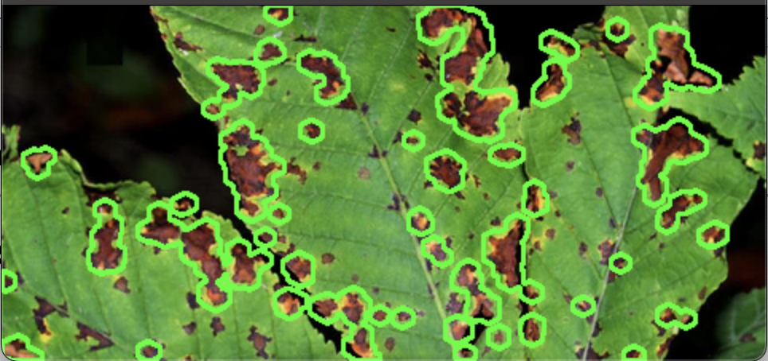
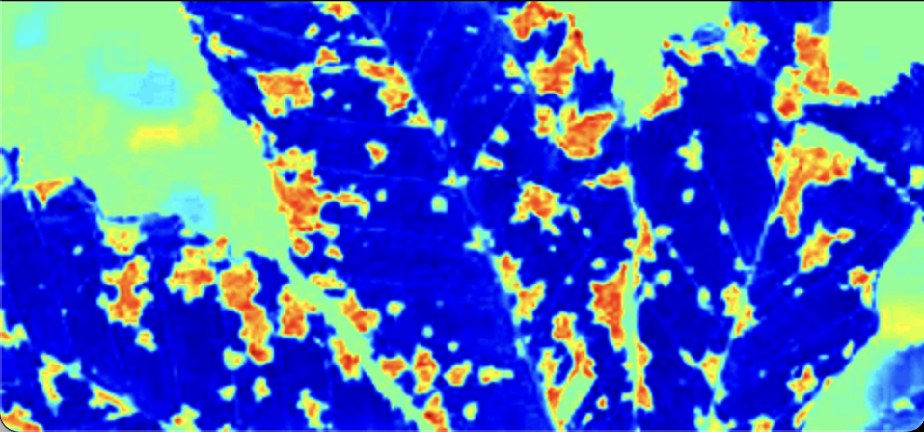
Other Possible Implementation
Disease detection for plant
Rust and Bacterial Canker & Red Blotch
Speaker: Mingyang Yu
Notes:
Another implementation is for the agriculture. These disease is called rust, canker or sometime is red blotch. Canker is a bacterial disease which infect the stem and leave of peaches, cherries. So detect earlier, control earlier

Slide 23
Future Improvement
Enhanced Accuracy:
Train an AI model to improve precision in identifying various types of acne, such as white heads, blackheads, and pustules.
Expanded detection capabilities:
Add functionality to detect addition skin conditions, including acne scars, dark spots, and post-inflammatory masks.
Location-Based Analysis:
Detect the specific location of acne on the face to provide personalized skin care recommendations tailored to the affected areas
Actionable Insights:
Offer advice on targeted treatments or preventive measures based on the acne’s type,severity, and distribution
Speaker:Hanze
Notes:
Speech Script: Future Improvements
Looking ahead, we see many exciting opportunities to improve our system.
First, we plan to enhance accuracy by training a more advanced AI model. This will help us better identify different types of acne.
Next, we aim to expand the system’s capabilities to detect more skin conditions, including acne scars, dark spots, etc
We’re also exploring location-based analysis to pinpoint the exact positions of acne on the face. This will allow us to offer personalized skincare recommendations tailored to specific areas.
Lastly, we want to provide actionable insights by suggesting targeted treatments and preventive measures based on acne type, severity, and distribution.
These improvements will make the system more precise, comprehensive, and helpful for both dermatologists and individual users. Thank you!

Slide 24
Questions?

